Slide 1
Simulation & Comparison of ARQ protocols
Sheetal Shalini 14CO142
Navya R S 14CO126
Data Communication Mini project

Slide 2
Introduction
In information theory and telecommunication, error detection and correction are techniques that enable reliable delivery of digital data over unreliable communication channels.
Many communication channels are subject to channel noise, and thus errors may be introduced during transmission from the source to a receiver.
Error detection techniques allow detecting such errors, while error correction enables reconstruction of the original data in many cases.

Slide 3
Error Control Protocols
The 3 error control protocols used for a noisy channel are:
Stop and wait ARQ
Go back N ARQ
Selective repeat ARQ

Slide 4
Stop and wait ARQ
The sender sends one frame at a time.
After sending each frame, it doesn't send any further frames until it receives an acknowledgement (ACK) signal.
After receiving a good frame, the receiver sends an ACK.
If the ACK does not reach the sender before a certain time, known as the timeout, the sender sends the same frame again.
Timer is set after each frame transmission.

Slide 5
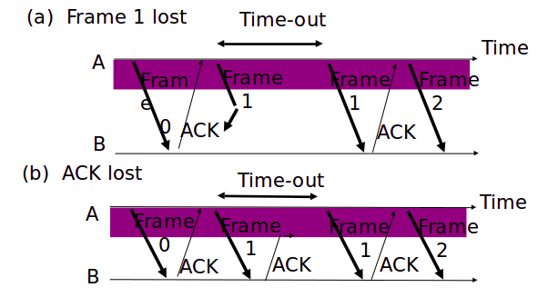

Slide 6
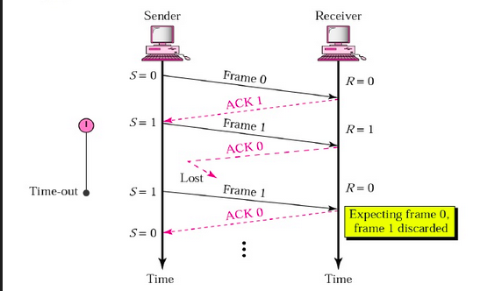
Sequence Numbers are alternating 0's
and 1's (modulo 2)

Slide 7
Go back N ARQ
It is a special case of the general sliding window protocol.
There are 2 sliding windows. One at the sender and the other at the receiver.
The window at sender has maximum size (2^m)-1, where m is the no.of bits in the sequence number contained in the header of the frame.
The window at receiver side has size 1.
The sending process continues to send a number of frames specified by the window size even without receiving an acknowledgement (ACK) packet from the receiver.
The receiver process keeps track of the sequence number of the next frame it expects to receive, and sends that number with every ACK it sends. The receiver will discard any frame that does not have the exact sequence number it expects (either a duplicate frame it already acknowledged, or an out-of-order frame it expects to receive later) and will resend an ACK for the last correct in-order frame.

Slide 8
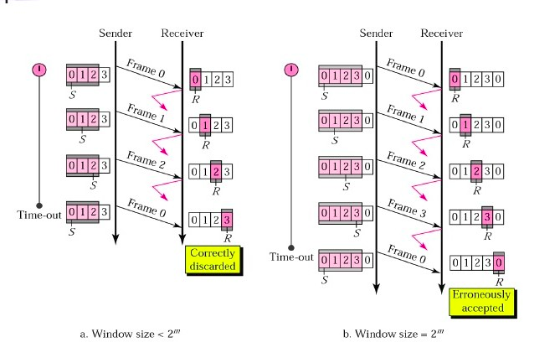
Why should the window size be less than 2^m​?

Slide 9
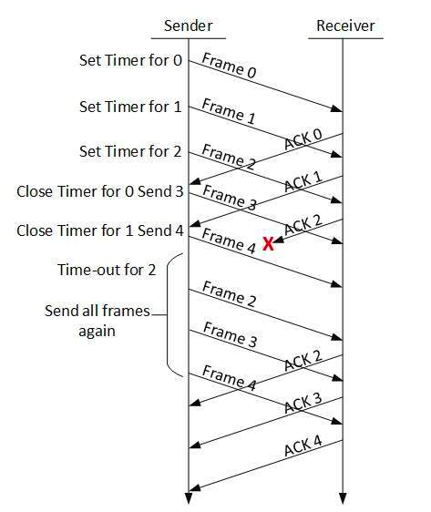
Drawback

Slide 10
Selective Repeat ARQ
This protocol uses the sliding window concept too.
The size of the window at the sender and receiver side is 2^(m-1), where m is the no.of bits in the sequence number contained in the header of the frame.
The receiver process keeps track of the sequence number of the earliest frame it has not received, and sends that number with every acknowledgement (ACK) it sends. If a frame from the sender does not reach the receiver, the sender continues to send subsequent frames until it has emptied its window. The receiver continues to fill its receiving window with the subsequent frames, replying each time with an ACK containing the sequence number of the earliest missing frame. Once the sender has sent all the frames in its window, it re-sends the frame number given by the ACKs, and then continues where it left off.

Slide 11
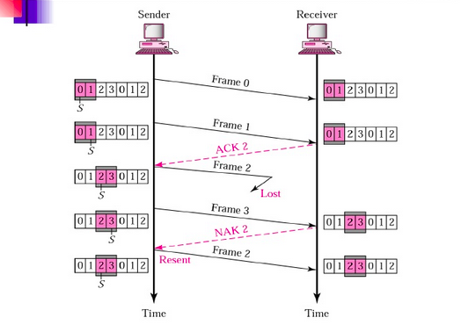

Slide 12
Comparison
Efficiency of stop and wait arq is very less because the sender and receiver window size is 1 and no pipelining.
Selective repeat is more efficient than go back n because it minimizes the amount of re-transmission.
But the receiver must maintain a buffer large enough to save frames until the frame in error is re-transmitted and must contain logic for re-inserting that frame in the proper sequence. The transmitter, too, requires more complex logic to be able to send a frame out of sequence. Because of such complications, selective repeat is less widely used than go back n.

Slide 13
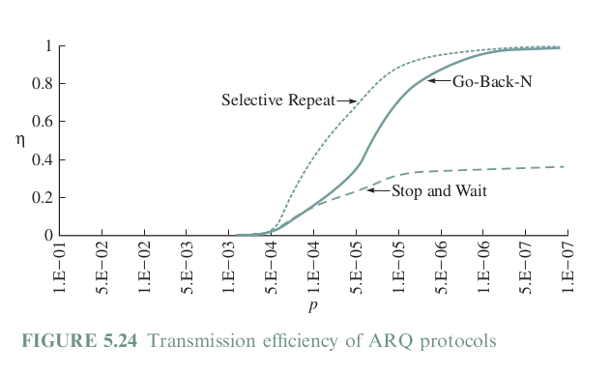

Slide 14
